Slide 1

Lesson: 1.02 Interactive Mode
Microsoft Philanthropies TEALS Program – Introduction to Computer Science – Semester 2

Slide 2
Interactive Mode
After this lesson, you will be able to...
Define and identify interpreter, string, integer, float, value, errors, console, expression
Use the Python interpreter to evaluate simple math expressions
Distinguish between an integer, float, and string

Slide 3
Today’s Plan
Do Now
Lesson
Lab Part 1 Discussion
Lab Part 2 Discussion
Debrief
Notes:
5 Minutes - Do Now
10 Minutes - Lesson
15 Minutes – Lab Part 2 Discussion
20 Minutes – Lab Part 2 Discussion
5 Minutes - Debrief

Slide 4
Do Now
Read the Following 1.1 Associated readings
https://tealsk12.github.io/2nd-semester-introduction-to-computer-science/readings.md.html
In your Notebook,
Write down three major learning from the reading.

Slide 5
Class Introductions
One at a time, Stand up and Introduce yourself to the class.
Your name / what you like to be called
Your preferred pronouns (e.g “she, her, hers”, “they, them, theirs”)
Any experience you have programming.

Slide 6
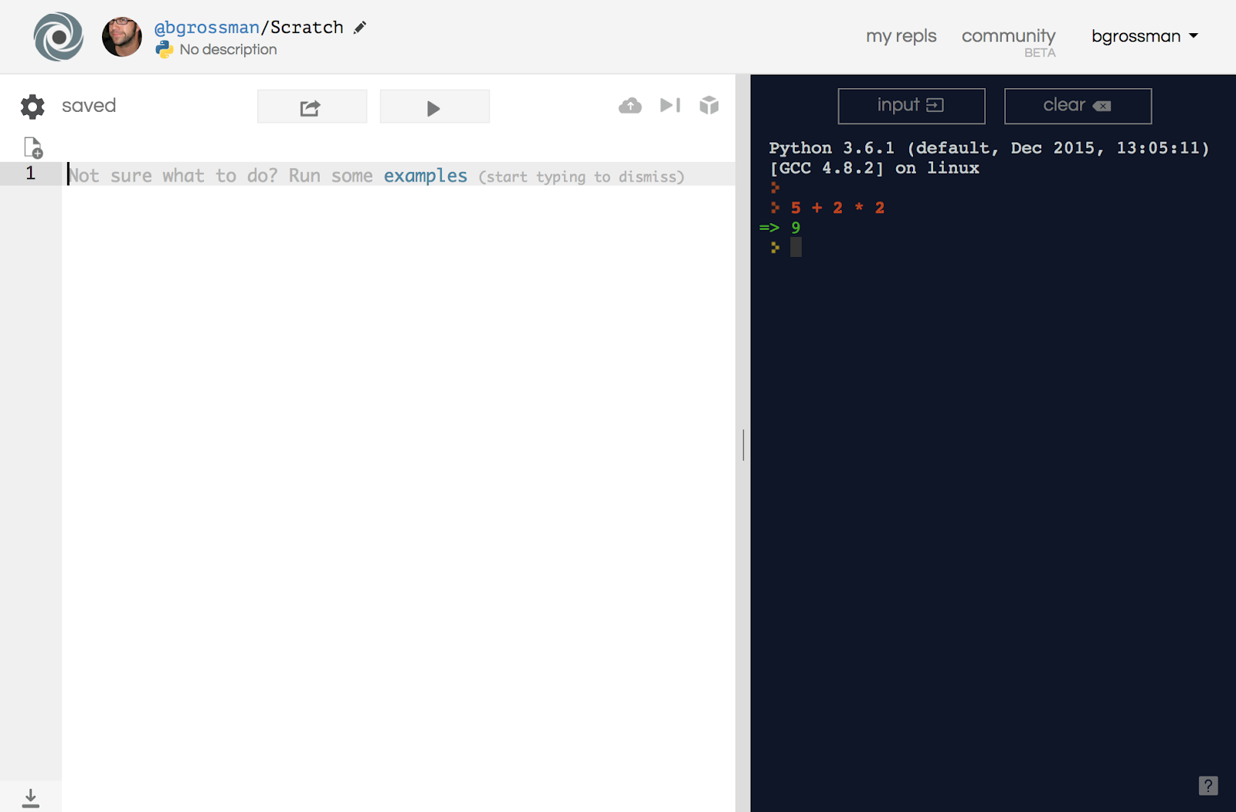
Using the Interpreter
Type Here

Slide 7
Key Terms – Write in your Notebook
Value - A single piece of data in Python (e.g. 2, “Hello, World”).
Type - A classification for data which tells the interpreter how it will be used.
Integer - A type containing a whole number …, -2, -1, 0, 1, 2, …
String - A type containing a series of characters. Usually written using quotes (e.g. “Hello, World”).
Float - A type containing a decimal value.
Operators - Symbols that represent computations (e.g. +, -, /, *).
Expressions - A combination of values, variables, and operators. (e.g. 2+3).
Statement - A unit of code that Python can execute.
Variable - A name that refers to a value.

Slide 8
Lab 1.03 – Section 1 Discussion
What does the // do?
How is that different from /?
And how are those different from %?
What’s the difference between 3.0 and 3?
Key Terms
Floats: a data type, number with a decimal point.
Integers: a data type, number without a decimal point.
Now work through Section 2

Slide 9
Lab 1.03 – Section 2 Discussion
What happened when you typed in a?
What do you think that error message mean?
Key Term
String: a data type, characters surrounded in single or double quotes.
Now, work through section 3

Slide 10
Lab 1.03 – Section 3 Discussion
What was the difference between the two inputs?
Strings can be combined using +.
What do you think the error message means?
You can’t combine different types!
Now, work through section 4

Slide 11
Lab 1.03 – Section 4 Discussion
What error did you get?
What do you think that means?
What happens when you multiply strings?

Slide 12
Lab Part 2
Define expression: a combination of values and operators (and variables)
In your notebook,
Give an example of an expression
Write down their predictions before going to the interpreter/IDE to check the actual output.

Slide 13
Debrief/Exit Ticket
In your notebook,
Write down what you remember about Order of Operations you learned in math class
Show a volunteer or teacher on your way out of class.

